Slide 1

Telco Customer Churn Analysis
Strategic Insights & Revenue Retention Roadmap

Slide 2


Project Overview
Executive Summary
My analysis identifies critical friction points in the customer lifecycle. The primary objective is to address the current churn volatility and stabilize subscriber base.
Target KPI
Stabilize and reduce the benchmarked 26.58% churn rate through data-led interventions.

Slide 3
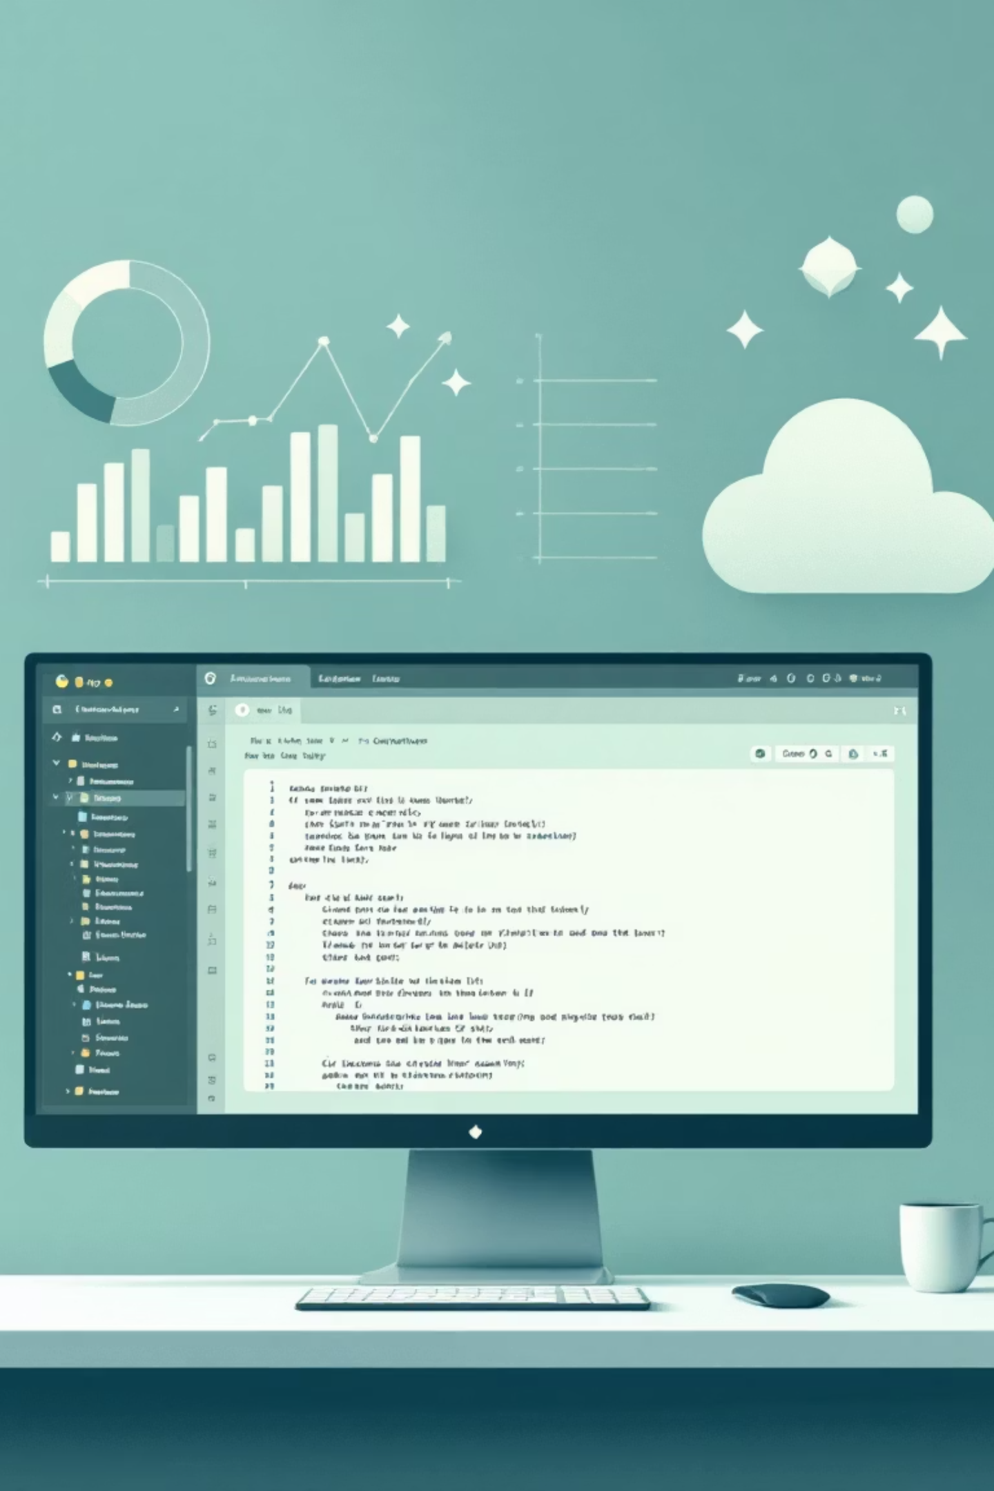
Methodology
Data Audit & Integrity
Ensuring high-fidelity insights through rigorous preprocessing using Python.
Type Conversion
Imputation Strategy
Converted TotalCharges from object to numeric to enable financial modeling.
Identified and handled missing values in tenure-based features to prevent bias.
Feature Engineering
Normalised monthly spend data to compare high-value vs. budget segments.

Slide 4
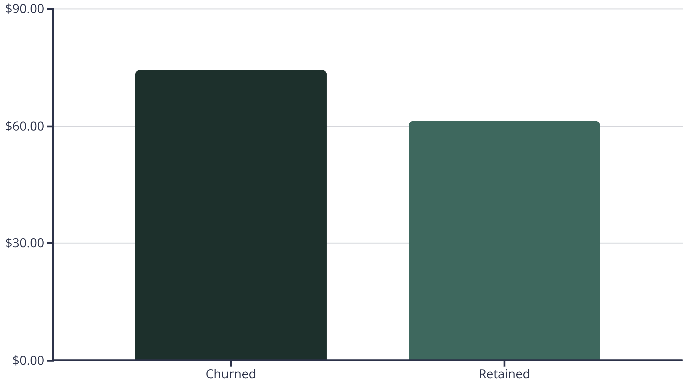
Price Sensitivity
The Big Driver: Monthly Costs
Data confirms a 21% cost gap. High-spend customers are significantly more likely to exit, suggesting a lack of perceived value for the premium price point.

Slide 5
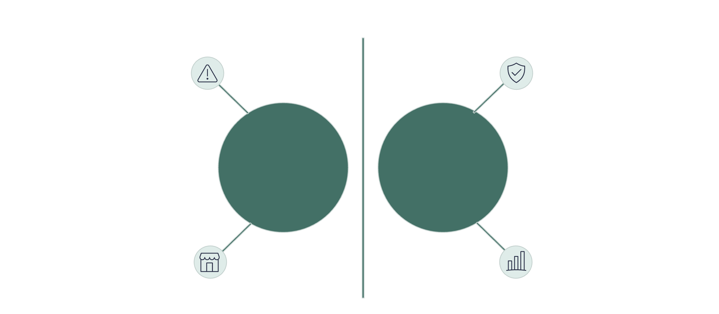




Retention Risk
Contract Structure Analysis
Short-term flexibility is our largest vulnerability point.
Highest churn frequency
Lower churn risk
Month-to-Month
One/Two Year
Perpetual shoppers
4x greater retention
Month-to-Month
Long-Term
Highest churn frequency. These customers act as 'perpetual shoppers'.
Annual contracts show 4x higher retention rates than monthly plans.

Slide 6
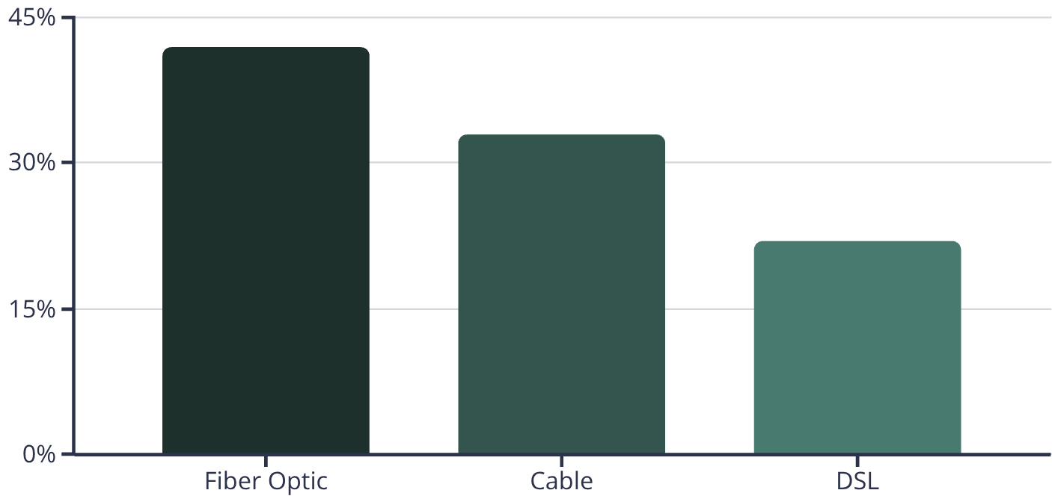




Product Performance
The Fiber Optic Paradox
41.89%
Churn Rate on Fiber
Despite offering superior speeds, Fiber Optic users churn at nearly double the rate of DSL users. This represents our highest churn segment.
The Paradox: Superior Speed ≠ Customer Loyalty. Our fastest service segment shows the highest churn.
Strategic Insight: The Fiber Paradox reveals a critical gap between product capability and customer satisfaction. Addressing non-speed factors is key to unlocking fiber's full revenue potential.
Pricing Structure
Customer Experience
Value Perception
Premium pricing drives price sensitivity; customers are switching to save ~20% on monthly bills despite speed loss.
Complex billing and average 15-minute hold times for support calls negate performance advantages, leading to frustration.
Only 30% of fiber users frequently utilize full speeds, diminishing perceived benefit over more affordable alternatives.

Slide 7


User Experience
The Critical Service Gap
63%
High Churn Without Technical Support
63% of churned customers had no technical support plan.
Without Tech Support
With Tech Support
Support Gap
Resolution Time
NPS Impact
Customers without support churn at 4x the rate.
Resolution time is 2.5x longer for unsupported customers.
NPS for unsupported customers is -30 vs +45 for supported.

Slide 8
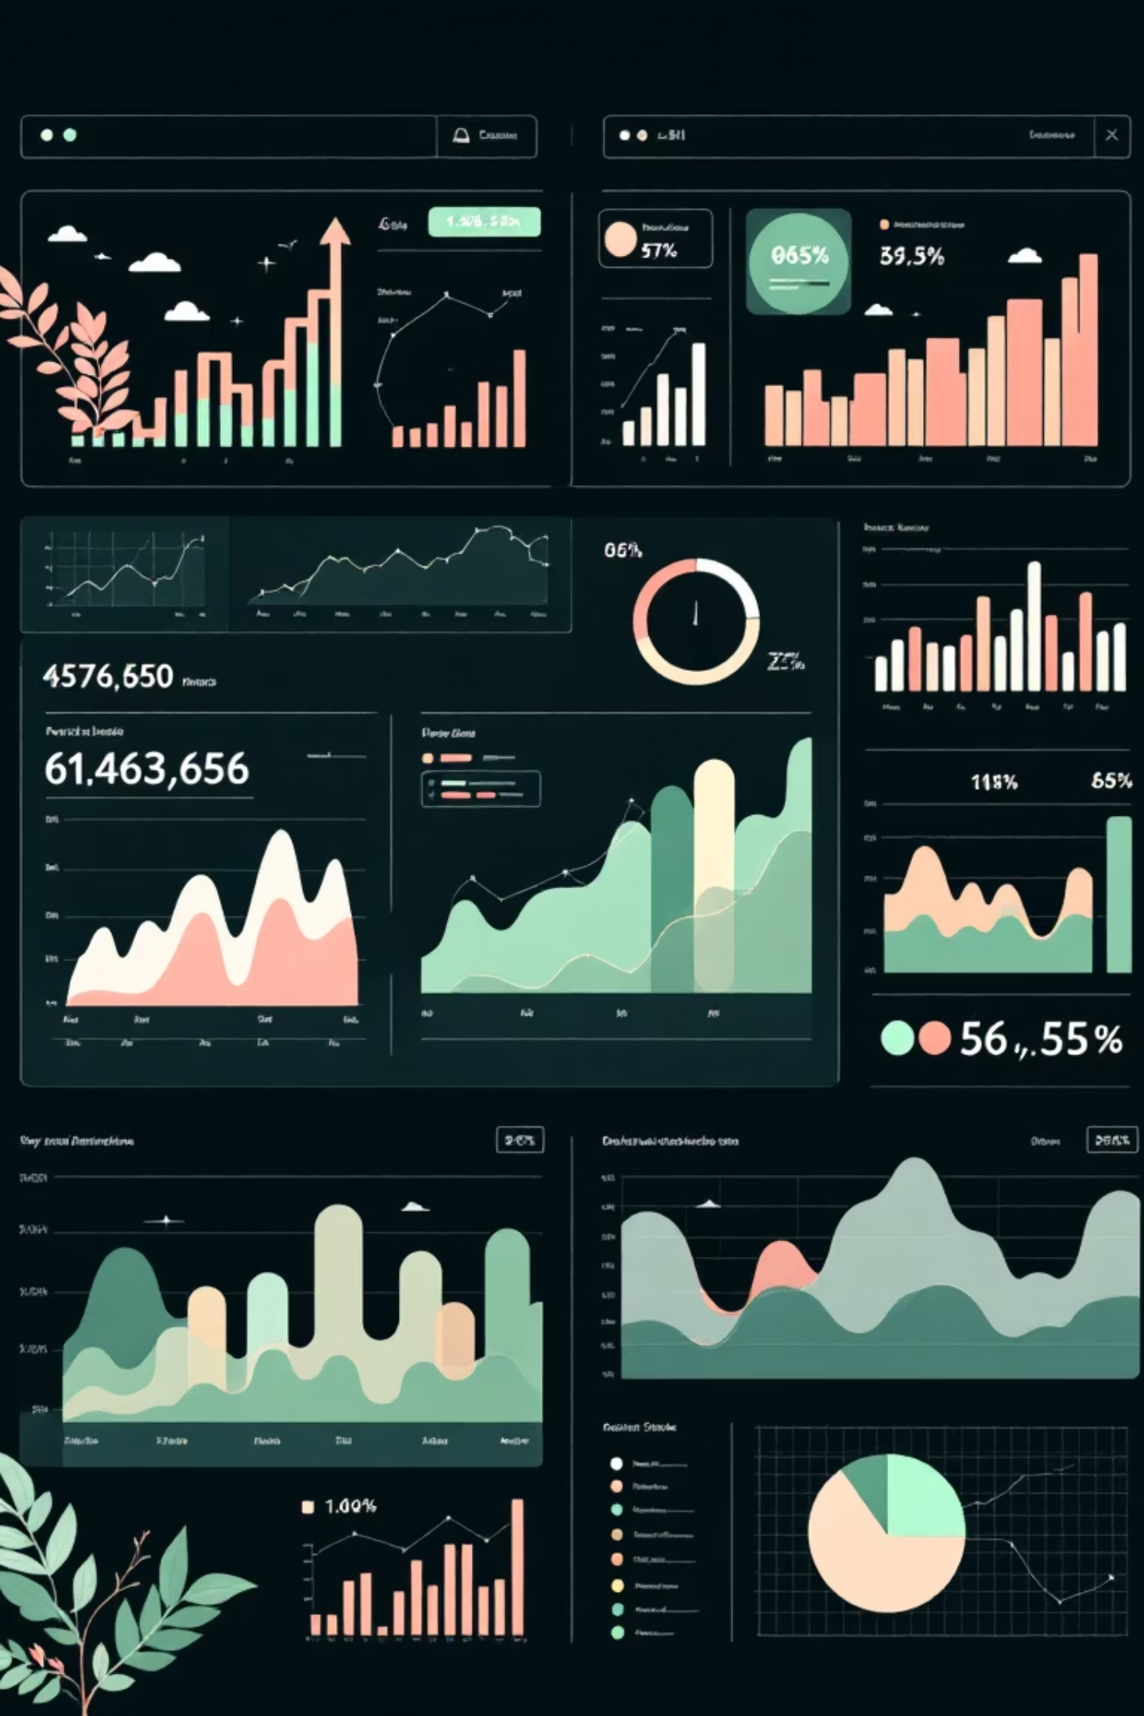



Analytics Tool
Interactive Churn Dashboard
We have deployed a Power BI solution for real-time segment monitoring.
Dynamic Slicers
Filter by geography, contract type, and payment method.
Risk Scoring
Identifies "At-Risk" segments before they reach the billing cycle end.
Revenue Impact
Visualises the dollar value of potential churn saved.

Slide 9




Strategic Action Plan
Integrated Churn Mitigation Strategy
Optimize Contract Pathways
Enhance Service Bundling
Proactive Retention Outreach
Targeting an estimated 15% churn reduction.
Projected to increase CLV by $200+ per customer.
Aiming to boost retention by 10% among top clients.
These strategies target the top 3 critical churn drivers for maximum impact.

Slide 10



Strategic Impact: Maximizing Revenue & Growth
Transitioning to a proactive support model will safeguard our high-ARPU Fiber segment.
Reduced CAC
Boosted CLV
Streamline acquisition costs.
Maximize customer lifetime value.
Lower acquisition costs through improved retention and reduced churn-driven replacement spending.
Extended customer relationships and increased service adoption drive higher lifetime value.
Stable Revenue
Ensure predictable quarterly growth.
Predictable recurring revenue from longer contract commitments and reduced churn volatility.
Decisive Action for Sustainable Success.

